Slide 1
Proposal Defense September 15, 2017

Slide 2
Researcher’s Profile:

Slide 3
Development of Information Kiosk with Android Application Control for Bacoor National High School

Slide 4
Background of the Study
Problems
Causes
Effects
No proper source of information in public
Time-consuming transactions in public offices
Lack of personnel in information desks
No appropriate instructions for the public
Confusion among the public
Inefficient service and disorderly transactions
Perceived Solution:
Development of Information Kiosk with Android App

Slide 5
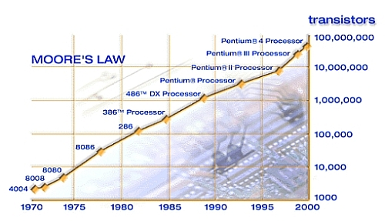
Background of the Study

Slide 6
Background of the Study
Technology is evolving
As students who specialize in technology, we aim to integrate technology in our daily lives
Home Automation
Transportation
Education
Business and Industry
Daily transactions

Slide 7
Objectives of the Study
The general objective of the study is to develop an information kiosk that would be Bacoor National High School’s first digital assistant.
Specifically the study aims to
Create a web-based program with the following features
Creative dashboard for the index page
Navigation buttons for categorized information
Android application for updating the information in the Kiosk to be used by the faculty
To subject the project for evaluation to IT professionals and IT students

Slide 8
Objectives of the Study
Specifically the study aims to
To test the project using the ISO 9126 instrument
Determine the level of acceptability of the developed mobile game application according to evaluation criteria using ISO 9126 instrument

Slide 9
Scope and Limitation of the Study
The project study focuses on the
Design
Creation
Testing
Improvement
Evaluation
Of the Information Kiosk with Android App
Survey will be conducted among the students and teachers of BNHS.
Preliminary research will be conducted during first semester of SY 2017-2018 and development begins immediately afterwards.

Slide 10
Topical Outline
Web Development - HTML - CSS - PHP
Content Management System - Overview of CMS - Purpose of CMS - Samples of CMS
Raspberry Pi - Basics of raspberry pi - What can a raspberry pi do? - Samples of projects using raspberry pi
Information Kiosks - Purpose of information kiosks - Samples of information kiosks

Slide 11
Conceptual Model
Input
Process
Output
Knowledge Requirements:
- Adobe Photoshop
- HTML/CSS/PHP
- Siberian CMS
- MySQL
Software:
- Adobe Photoshop
- Siberian CMS
- Notepad++
- LAMP(Linux, Apache, MySQL, PHP)
- Philwebhosting(Web hosting)
Hardware:
- Raspberry Pi 3
- Touchscreen Monitor
- Custom made platform
Project Design: - ERD - DFD - Block Diagram
Project Development: - Adobe Photoshop - Siberian CMS - Notepad++
Operation and Testing: - Philwebhosting - LAMP(Linux, Apache, MySQL, PHP)
Information Kiosk with Android Application
Evaluation

Slide 12
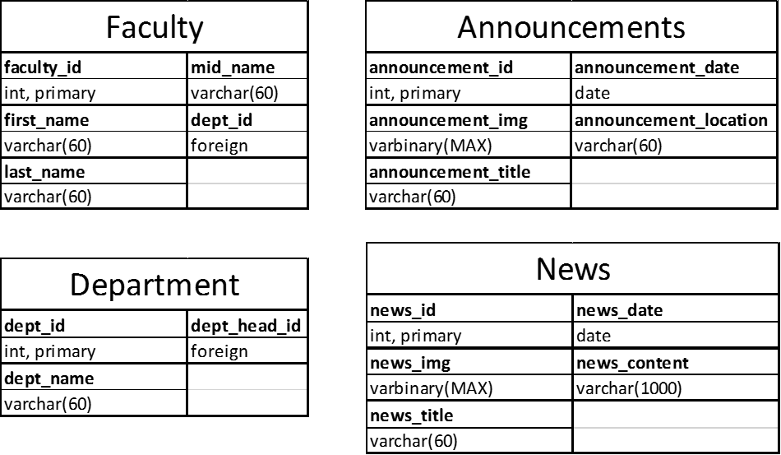
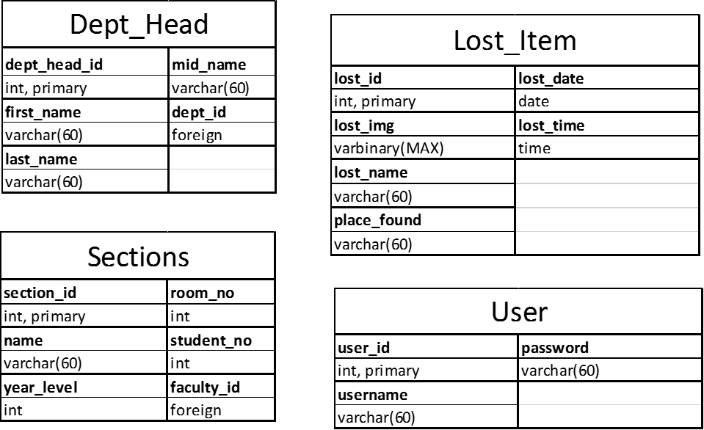
Project Design
Database Design for Information Kiosk

Slide 13
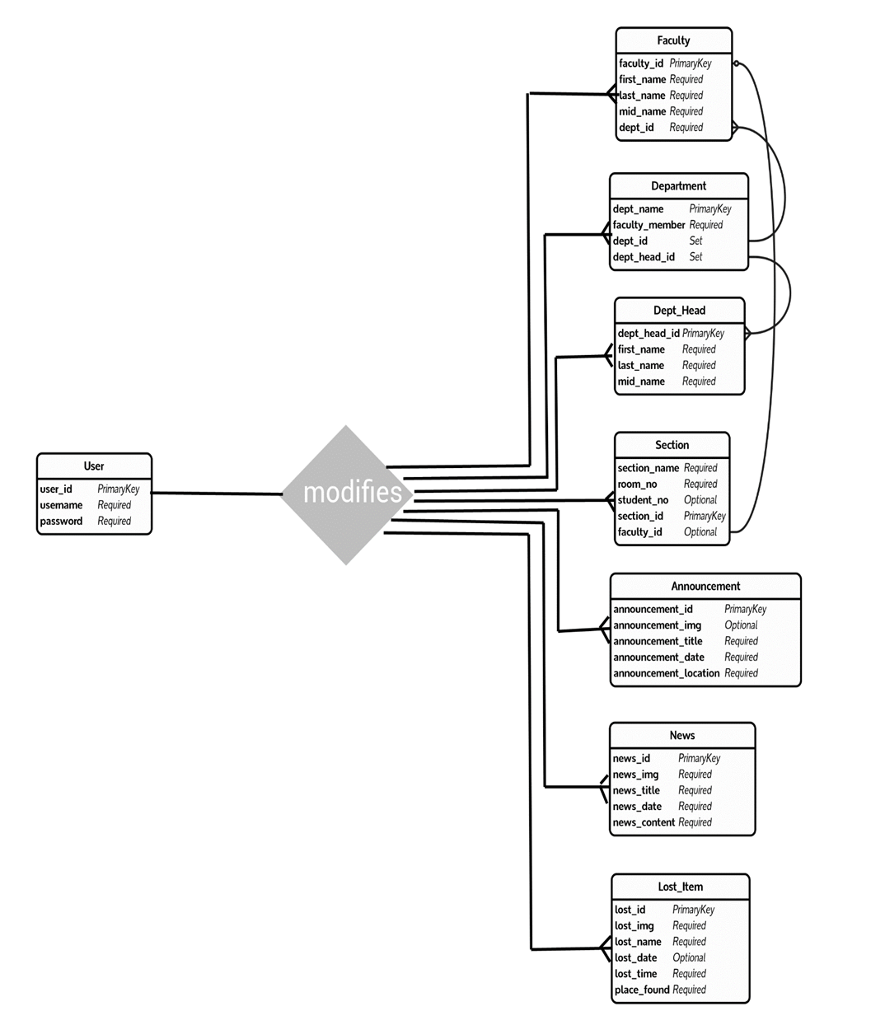
Entity Relationship Diagram between user and other entities

Slide 14
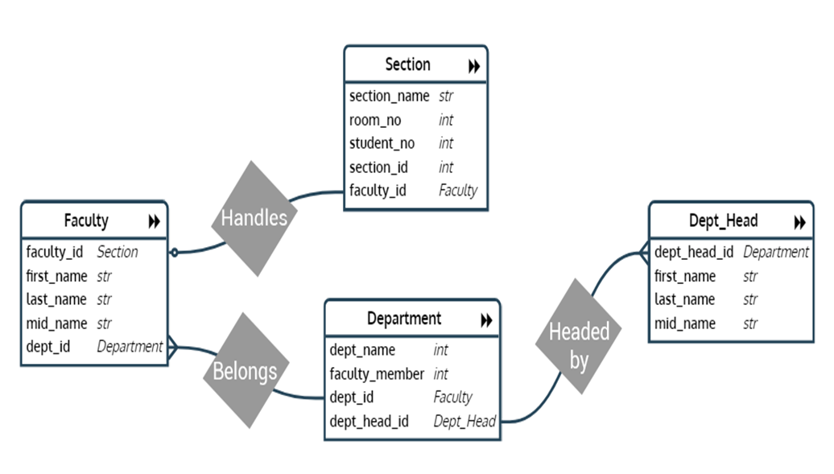
Entity Relationship Diagram between faculty, section, department and department head

Slide 15
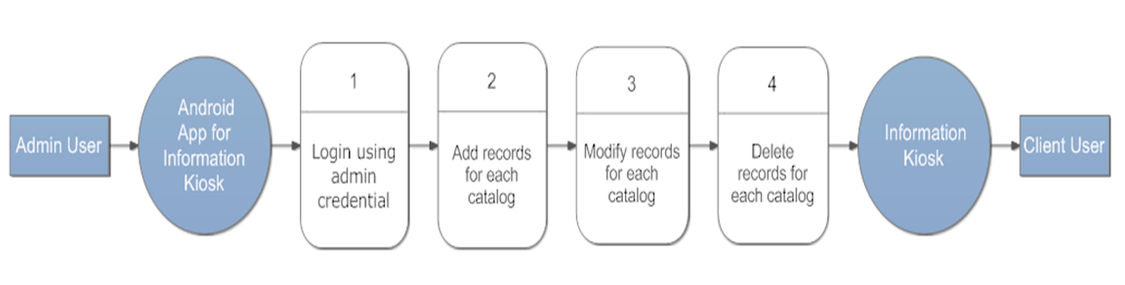
Data Flow Diagram

Slide 16
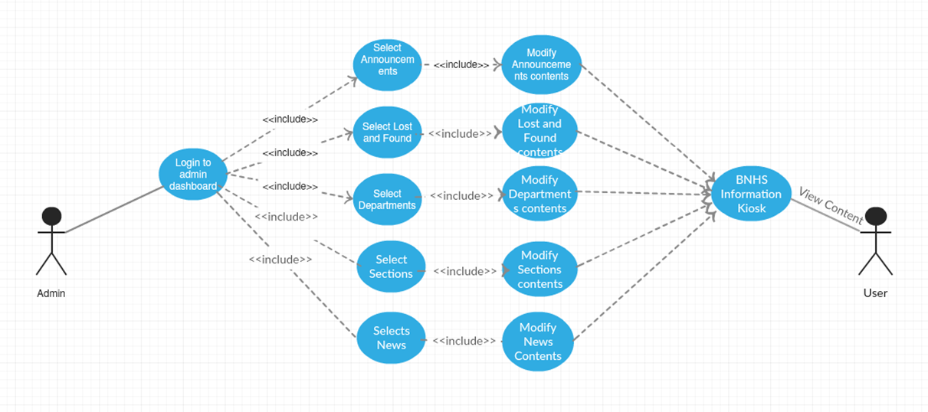
Use-case Scenario

Slide 17
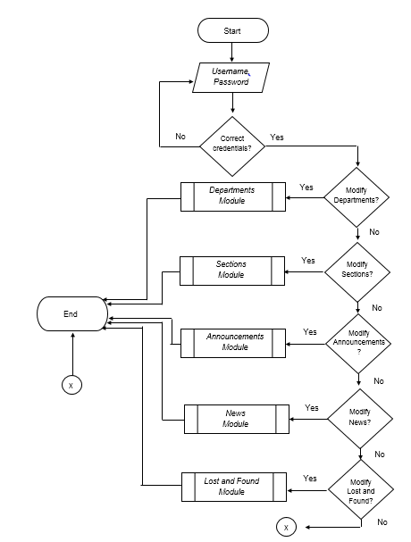
Flowchart of BNHS Information Kiosk with Android App

Slide 18
See pictures for Project Design

